Slide 1


ADVISORY BOARD OF TKBB

Slide 2

Position of the TKBB Advisory Board in the Current Shariah Governance Ecosystem of Turkey
Participation Banks Association of Turkey
(TKBB)
Participation Banks Advisory Committees Boards
Participation Banking Compliance Units
Advisory Board of TKBB
Banking Regulation and Supervision Agency (BRSA)
Participation Banking Auditing Units

Slide 3
Formation of the Advisory Board of TKBB
The Advisory Board of TKBB is a committee formed under the Association with the decision taken by the Board of Directors of the Participation Banks Association of Turkey (TKBB) on 02.05.2018 in line with the decision of the Banking Regulation and Supervision Board (BRSA) dated 22.02.2018 and numbered 7736.
The Advisory Board carries out its administrative and scholarly activities based on the "Communiqué on the Formation, Duty, Working Procedures, and Principles of the Advisory Board" dated 02.04.2018 and numbered 253 and the "Internal Directive on the Working Procedures and Principles of the Advisory Board" dated 27.06.2018 and numbered 260/2, both of which were adopted by the Board of Directors of TKBB.
The first members of the Board were appointed on May 2, 2018, and held its first meeting on May 10, 2018.

Slide 4

Advisory Board of TKBB
The Advisory Board of TKBB is an independent board established under the umbrella of the association.
The decisions and standards of the Board have a binding nature for participation banks.
The Advisory Board of TKBB is the central advisory board in Turkey.

Slide 5
Members of the Advisory Board of TKBB
The advisory board informs the public of its opinions and advices within the framework of the decisions taken unanimously or by majority in the regular meetings it holds.
The Board consists of seven members who serve for a period of four years.
It is mandatory that; four of the members have a Ph.D. in Islamic sciences,
One of them should be proposed by the Presidency of Religious Affairs, who is among the members of the High Board of Religious Affairs,
One of them has an undergraduate or graduate degree in one of the business, economics, finance, banking, law or equivalent diciplines, and at least seven years of managerial experience in the participation banking field, and
The other one has a law degree.

Slide 6
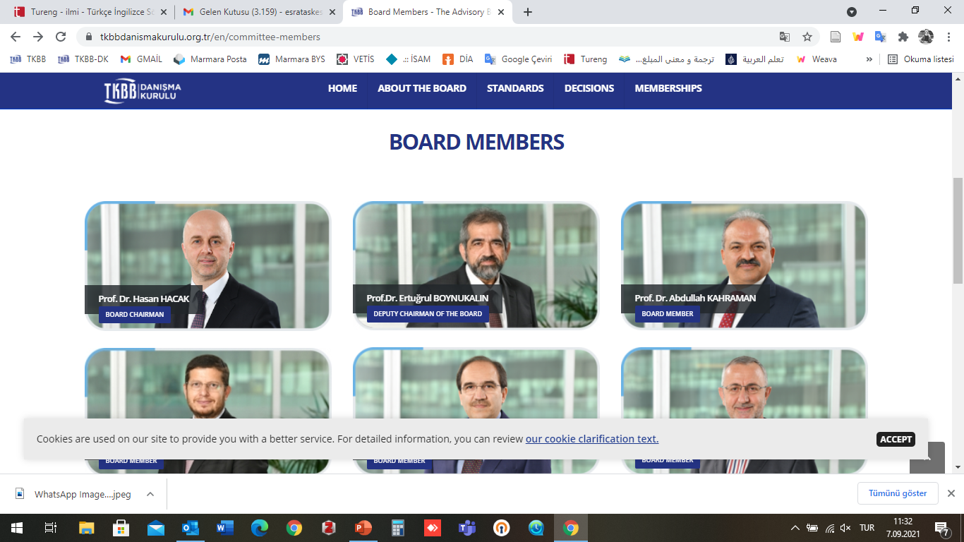
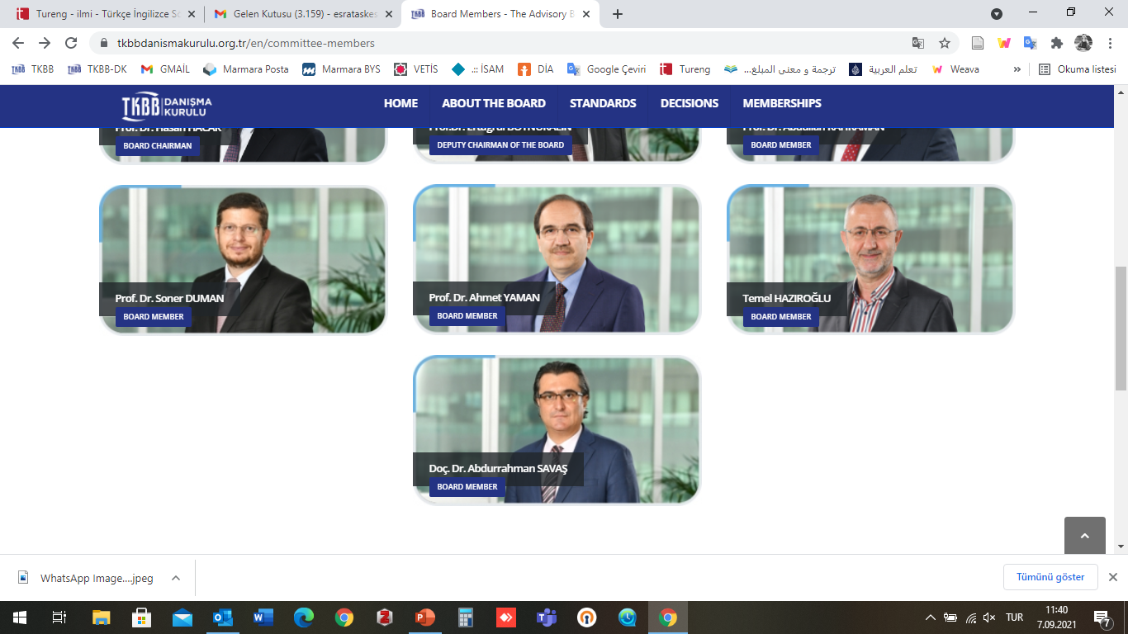
Members of the Advisory Board of TKBB

Slide 7
Secretariat of the Advisory Board of TKBB
Dr. Ali ÖZTÜRK, Manager
Dr. Cengiz ZAKİR, Board Specialist
Esra TAŞKESEN SANCAR, Board Specialist
Ercan CIVELEK, Board Specialist
Muhammet Enes KÖMÜRCÜ, Board Specialist
Abdullah Muhammet POSPOR, Board Specialist

Slide 8
Duties of the Advisory Board of TKBB
Determining the professional principles and standards for participation banks to follow,
When deemed necessary, taking general decisions to eliminate the practice differences among participation banks,
Upon application, providing opinions on interest-free financing activities to public institutions and organizations, public professional organizations, and other organizations,
Organizing programs and preparing publications to train and publicise the professional principles and standards of participation banking, and attend in the programs organized for this purpose,
The Advisory Board fulfills the duties assigned to it under its own responsibility, impartially, and independently.

Slide 9


Standard Development Process of the Advisory Board of TKBB
Islamic law resources, academic studies, practices in Turkey and the world, standards, industry practices
Determining the subject of the standard
Performance of the research activities and preparation of a report by the specialist
Preparation of the initial standard draft
Update of the report and the draft in line with the opinions of the relevant board member
Assigning a Board member and specialist for the standard
Inclusion of the draft standard in the agenda of the Board and finalization of its content in line with the opinions of all members of the Board
Revision of the draft standard prepared by the Board by the stakeholder institutions and conveying the opinions in this regard to the Board
Evaluation of the opinions from the Stakeholder Institutions
Organizing a workshop on the standard
Giving the standard its final form following the workshop
Submitting the standard to TKBB to be published and shared with the relevant organizations
Publication of the standard on the website

Slide 10
Standards of the Advisory Board of TKBB
The Board has 6 standards published currently:
• Share Certificate
• Tawarruq
• Murabahah
Suretyship
Mudarabah
Non Compliant Incomes with Participation Finance Principles And their Elimination
Standards in the preperation stage:
Musharakah
Wakalah
Investment Wakalah
Istısnâ’

Slide 11
Decisions of the Advisory Board of TKBB
Applications regarding the issues requested to be discussed in the Advisory Board are made to the Association. The Association examines the applications and may decide to return the applications that do not fall within the scope of the duties assigned to the Advisory Board or that may lead to a decision contrary to the current legislation.
The Advisory Board may also include in its agenda the issues it wishes to discuss.
Specialist personnel performs the research and examination activities, the preparation of the study reports, and other such duties required by the Advisory Board regarding the decision requests to be negotiated.

Slide 12
Decisions of the Advisory Board of TKBB
According to the agenda item of the meeting, representatives of a relevant institution or experts in their fields can attend the Advisory Board meetings. However, the decision session is confidential.
After the Board members complete their evaluation and negotiations, the decision is taken unanimously or by majority vote.
Decisions are written with their sharia bases. In the decisions, there is a summary of the subject examined and discussed, the text of the decision, and the sharia basis of it.
The members that dissent write a dissenting opinion.

Slide 13



THANK YOU

